Slide 1
University of Ljubljana
Faculty of Mechanical Engineering
Jaka Pribošek, Matija Brumat
Supervised by prof.dr. Janez Diaci
jaka.pribosek@fs.uni-lj.si
matija.brumat@fs.uni-lj.si

Slide 2
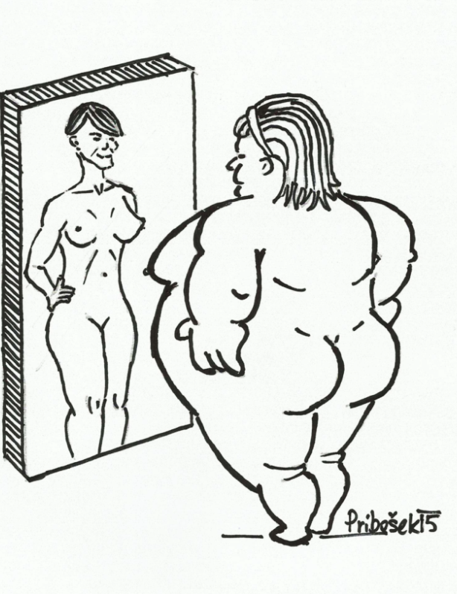
Why a deformable mirror ?
Adaptive imaging

Slide 3
Why a deformable mirror ?
Adaptive imaging
Aberration compensation
Source: NASA

Slide 4
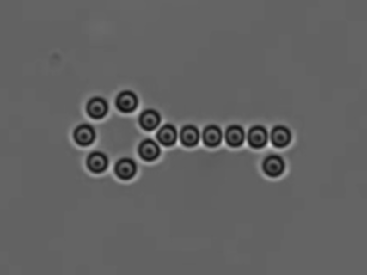
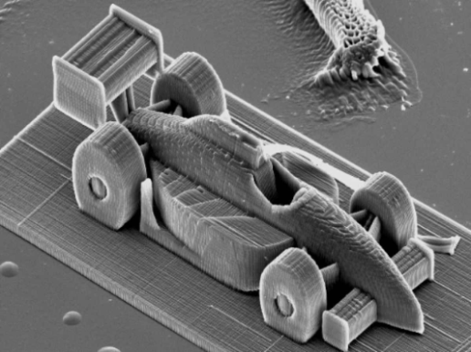
Why a deformable mirror ?
Adaptive imaging
Aberration compensation
Precision light manipulation
Source: Elliot Scientific
Source: NASA
Source: TU WIen
Technology, limited to priviliged institutions- what about others?

Slide 5
How does it work?
Piezoelectric diaphragm
Segmented electrodes
Curvature proportional to applied voltages
3 DoF : tip, tilt, defocus

Slide 6
The fabrication
Piezo buzzer
Coat with paint
Mark the electrodes
Etch the mounting arms
Solder wires
Glue the mirror

Slide 7
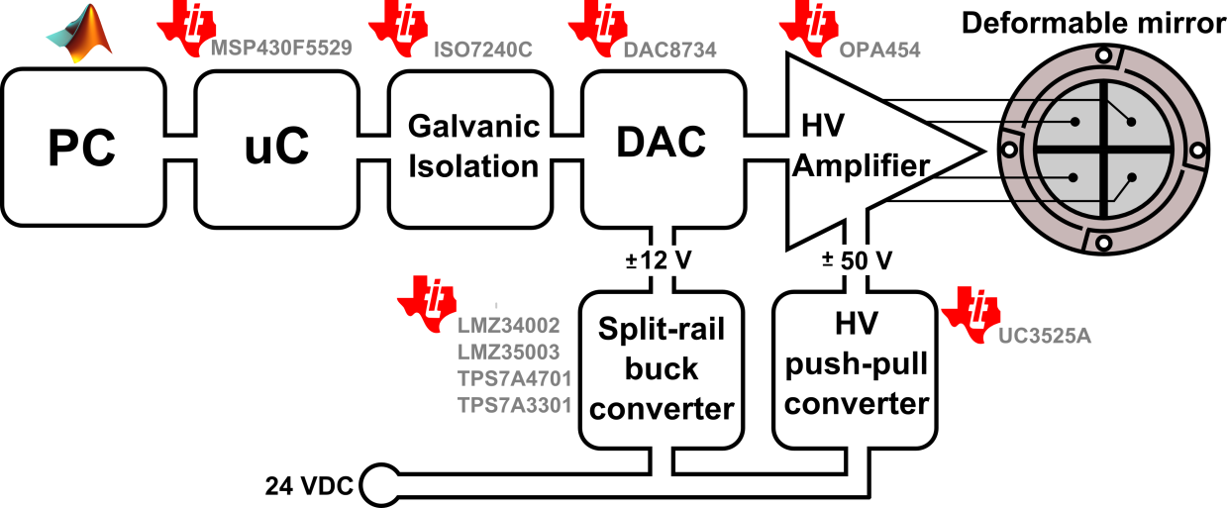
The electronics
10 TI integrated circuits
The heart is a quad bipolar DAC, amplified up to ±50 V
Ultra low-noise and high voltage switching power supplies
Microprocessor unit with onboard trajectory processing

Slide 8
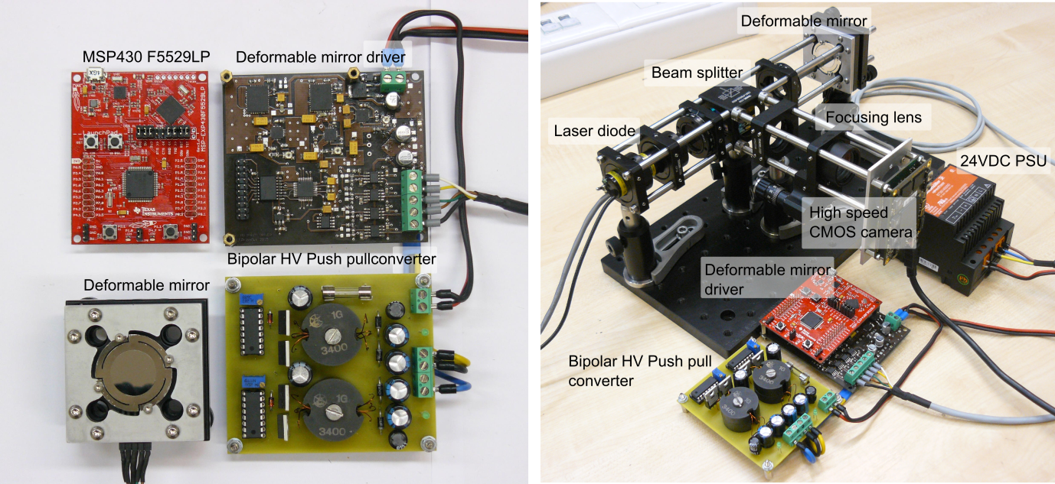
The complete system

Slide 9
Results
Processing speed: 75000 points/s
Angular deflection range: ±0.63°
Sensitivity: 0.02 mrad/V
Step response: 5 µs rise time, 6 % overshoot

Slide 10
Results
Processing speed: 75000 points/s
Angular deflection range: ±0.63°
Sensitivity: 0.02 mrad/V
Step response: 5 µs rise time, 6 % overshoot

Slide 11
Results
Processing speed: 75000 points/s
Angular deflection range: ±0.63°
Sensitivity: 0.02 mrad/V
Step response: 5 µs rise time, 6 % overshoot

Slide 12
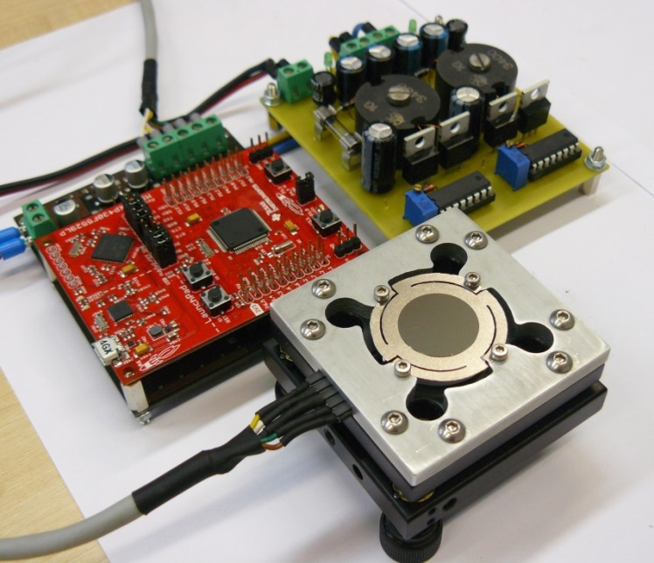
Summary
In 6 months we have developed:
a low-cost mirror fabrication
required electronics
optical system
software
Top-down development approach
TI Eval Boards for feasibility study
Webench for optimal analog design
Layout recomendations
TI free samples
Code examples (MSP430ware)
Final system…
…that anyone can build at home !

Slide 13
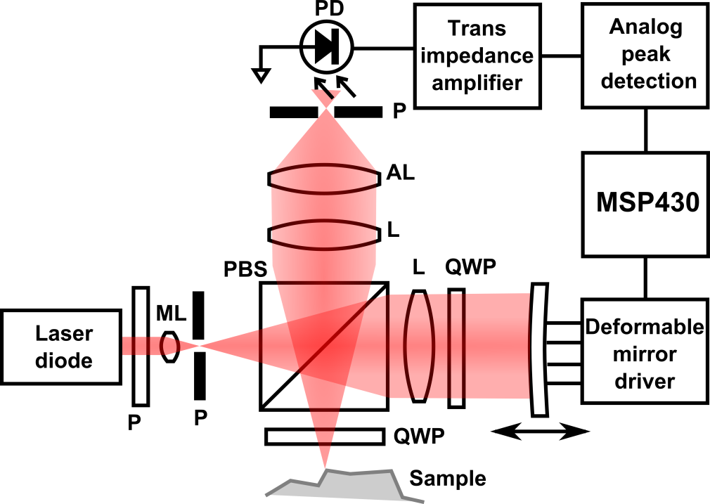
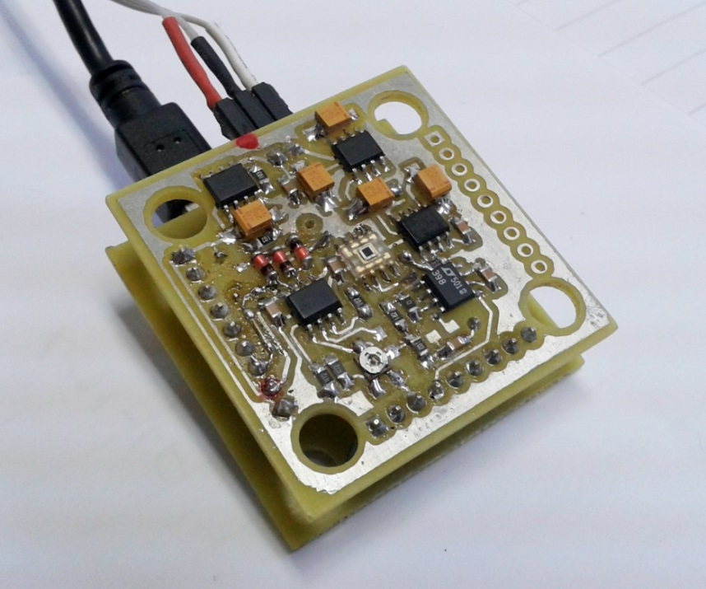
…and our future plans ?
….almost accomplished in the meantime!
confocal microscopy
3D topography inspection
analog peak detection circuitry
…5 more TI devices here…
Future is TI.

