Slide 1



A Wearable Embedded System for Wireless Acquisition of Vital Parameters
Roman Kusche, Paula Klimach, Ankit Malhotra, and Martin Ryschka
Laboratory of Medical Electronics (LME)
Lübeck University of Applied Sciences

Slide 2

Motivation
  An estimated 17.5 million people died from CVDs in 2012, representing 31% of all global deaths.
  CVDs are the leading cause of death in the world
https://pixabay.com/en/world-map-earth-global-continents-146505/
http://www.who.int/cardiovascular_diseases/publications/atlas_cvd/en/
http://newsroom.heart.org/news/new-statistical-update-looks-at-worldwide-heart-stroke-health

Slide 3
Motivation
State-of-the-art portable commercial patient monitoring devices measure Electrocardiogram (ECG), Photoplethysmogram (PPG), physical motions of the patient…
In addition to measurements currently available, our device provides an improved method for measuring “Pulse Wave Velocity.”
Gary F. Mitchell et al.: Arterial Stiffness and Cardiovascular Events, Circulation, 121, 2010, 505-511

Slide 4
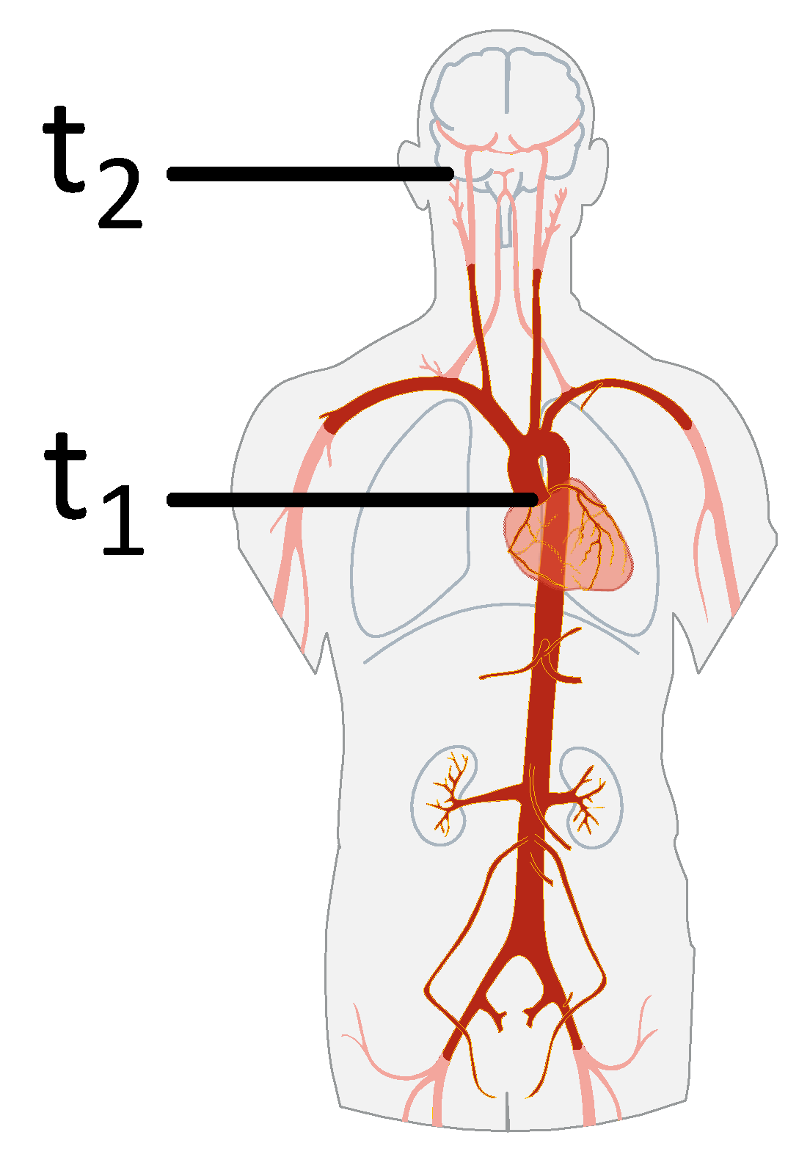

Measurement of the Pulse Wave Velocity (PWV)
t2: Pulse Wave Arrival
Pressure changes in the sealed ear canal
t1: Pulse Wave Start
Heart Sounds
Δx
$$PWV≈\frac{∆x}{t_{2}−t_{1}}$$
(1)
http://wikipedia.es

Slide 5
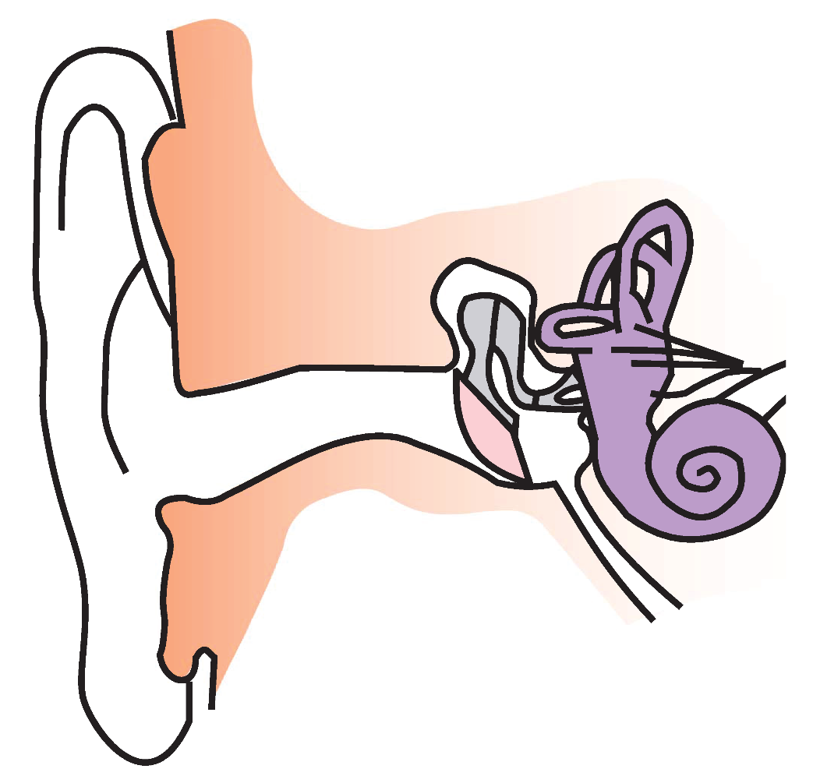
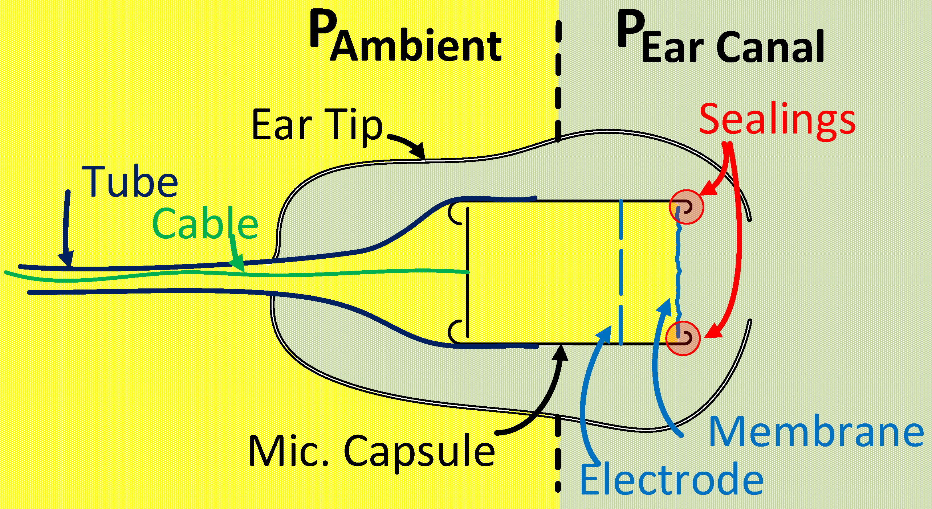
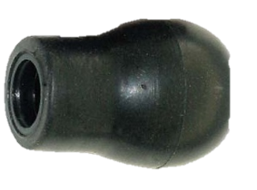
InEar-Sensor
Just ONE sensor to acquire 2 signals (Pressure + Heart Sounds)
Simple principle
Easy to use
Cheap (<1 €/Sensor)
Pressure Changes (t2) &
Heart Sounds (t1)
Sensor
http://de.wikipedia.org

Slide 6


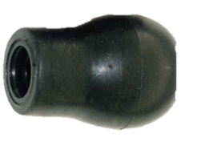
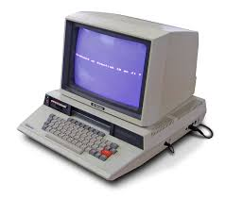

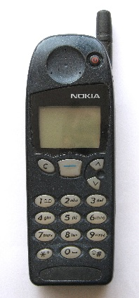
Measurement System
Physical motions of the patient could be interesting in the future!
An additional technique to prove the arrival of the PW would be good!
An ECG to compare the signal timing would be helpful!
Can you prove that you are measuring heart sounds?
The device should be portable!
Keep it simple, compact and cheap!
ADC
ADC
Mic. Amp.
ADC
ADC
µC
USB
LMV844MT
Mic. Amp.
InEar Sensor
LMV844MT
Mic. Amp.
ADS131E06
PC
LMV844MT
ADS131E06
µSD Card
Mic. Amp.
ADS131E06
LMV844MT
Patient
Power Supply (Li-Ion)
ECG
INA126E, LMV844
TPS63001, TPS73025, TPS72325
PPG
OPA380
Bluetooth
Acc. Sens.
LMX9838
Smartphone
http://freestockphotos.biz
http://pixabay.com
http://de.wikipedia.org

Slide 7
The Right ADC to Save Components
Typical problem:
  DC and AC are important
  DC/AC ≈ 1000
Typical Solution: Filtering
Our Solution:
  High resolution ADC (ADS131E06)
  ENOB(1kSPS) = 20.4 Bits
  Ideal Case: ≈ 10.4 Bits left for AC component
http://www.ti.com/graphics/folders/partimages/ADS131E06.jpg

Slide 8
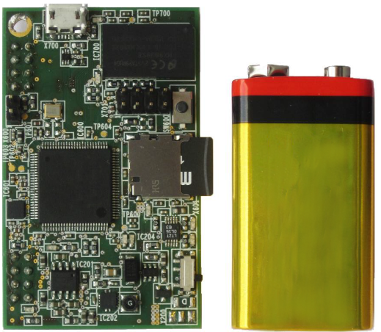
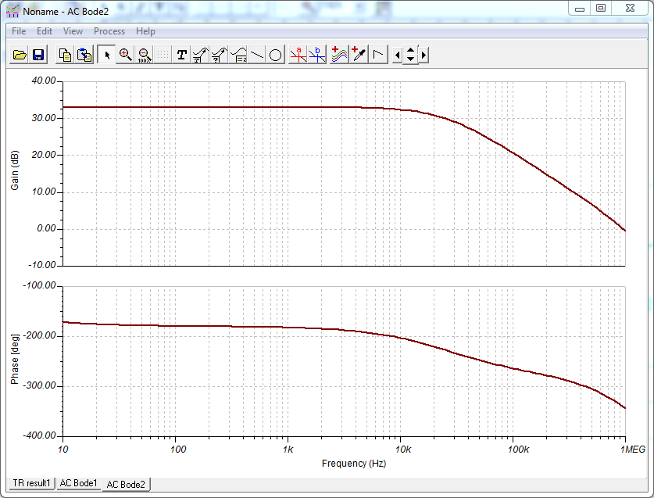
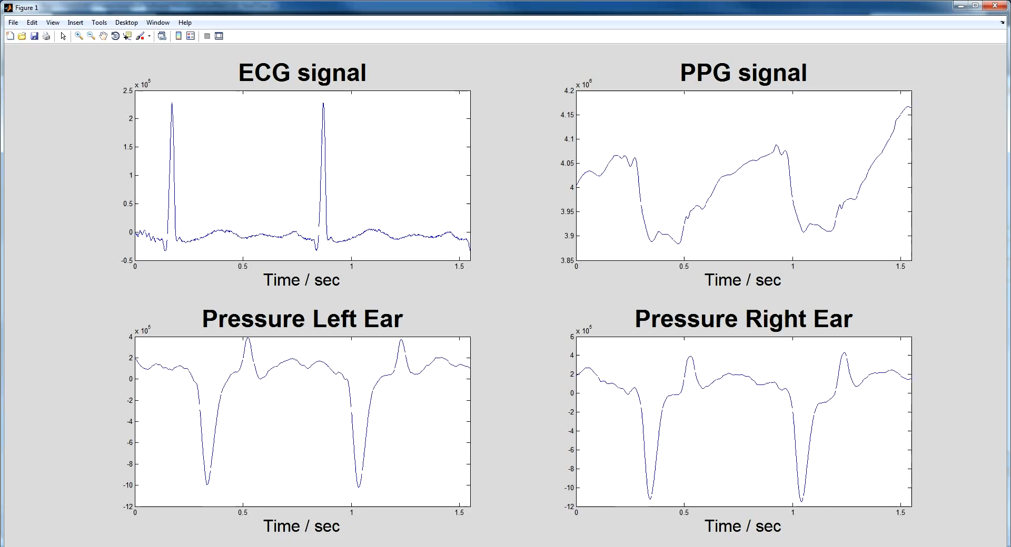
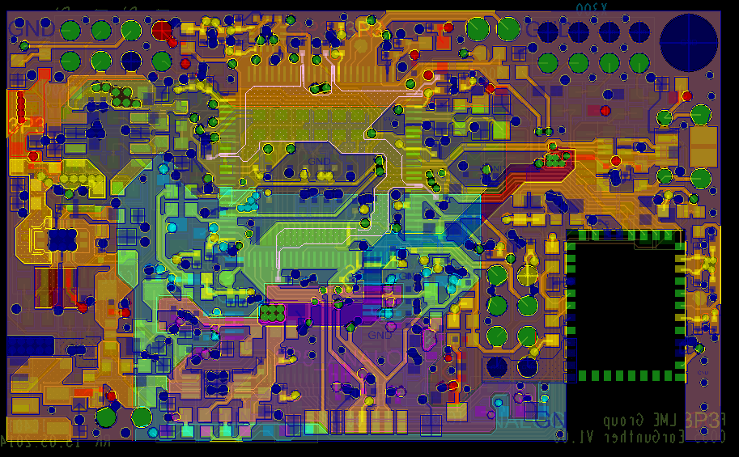
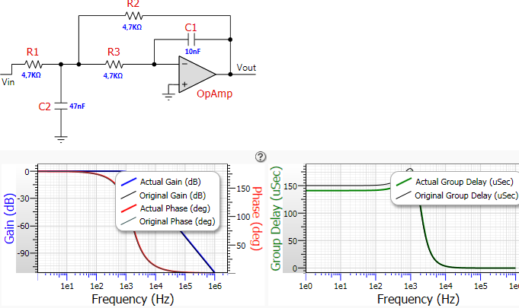
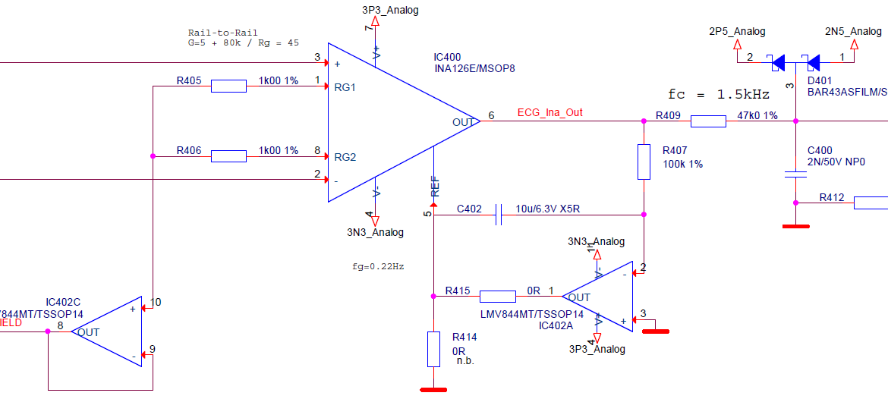
Realization

Slide 9
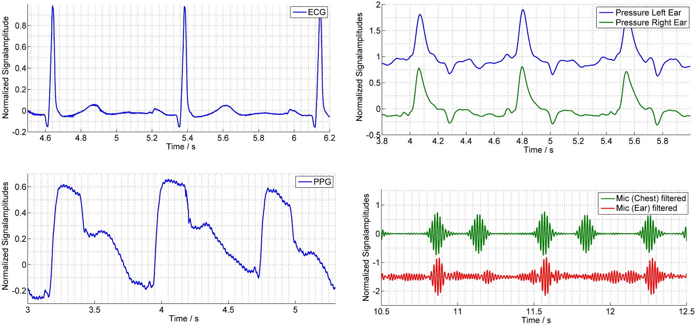
Results (RAW Data)

Slide 10
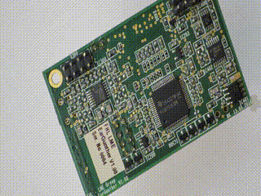
Conclusion
Wearable system for acquisition of:
Less components because of usage of high resolution ADC (ADS131E06)
Analog circuits were simplified but still deliver high quality data
The system has portability and is low-cost
ECG
PPG
Heart Rate Variability
Acceleration
Pulse Wave Velocity
Conventional (Cardiovascular)
Parameters
Cardiovascular
Prognostic Marker

Slide 11





Thank you for your attention
Roman Kusche^{1,2}, Paula Klimach^{1,2}, Ankit Malhotra^{1,2,3}, and Martin Ryschka¹
¹Laboratory of Medical Electronics, Lübeck University of Applied Sciences, Lübeck, Germany
²Graduate School for Computing in Medicine and Life Sciences, Universität zu Lübeck, Lübeck, Germany
³Institute of Medical Engineering, Universität zu Lübeck, Lübeck, Germany
http://lme.fh-luebeck.de
Grant number 13EZ1140A/B

